Slide 1



Slide 2
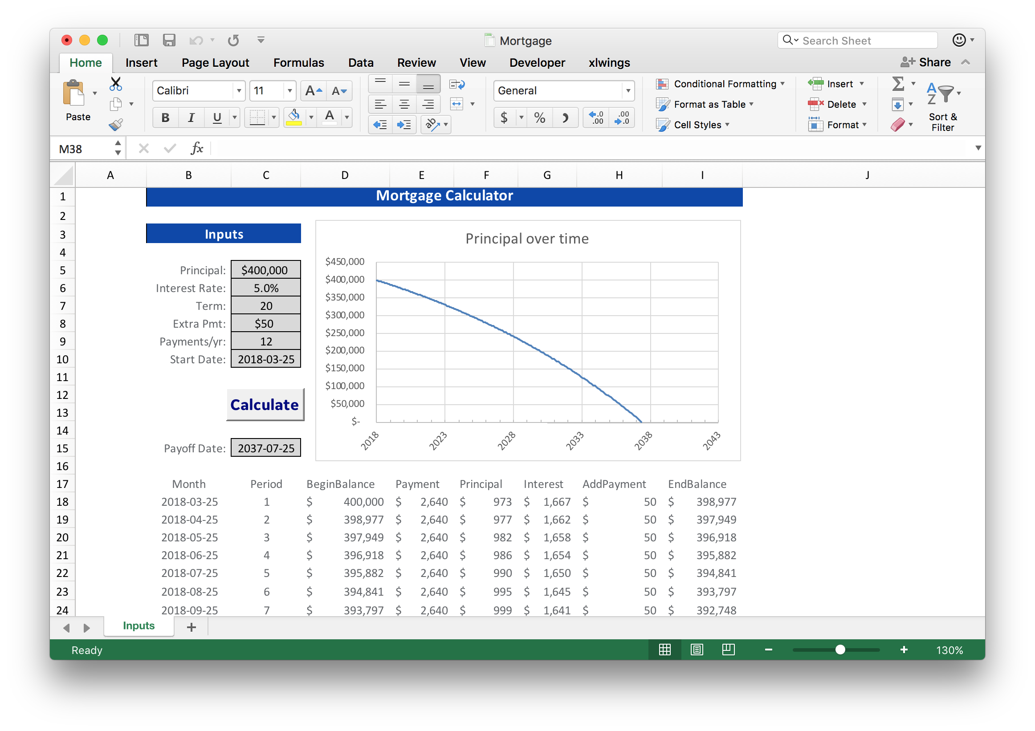
Inputs
Excel chart
Macro
Outputs

